Slide 1
Random Forest

Slide 2
CONTENTS
definition
How Random Forest Works
Advantages of Random Forest
Random Forest in Python (Code Examples)
conclution

Slide 3
definition
Random Forest is a powerful machine learning algorithm used for both *classification* and *regression* tasks. It operates by constructing multiple decision trees during training and outputting either the mode of classifications (for classification) or the mean prediction

Slide 4
How Random Forest Works

Slide 5
Bootstrap Aggregation (Bagging): Random Forest creates multiple subsets of the original data (with replacement). - Each subset is used to train a decision tree.
Feature Randomness: When splitting nodes, Random Forest randomly selects a subset of features. This reduces overfitting and increases the model's diversity.
3. Voting/Averaging: In classification, predictions are made using majority voting. - In regression, predictions are averaged across trees.

Slide 6
Advantages of Random Forest

Slide 7
Reduces overfitting by combining multiple trees.
Handles both categorical and numerical data.
Works well with missing and unscaled data.
Can handle large datasets efficiently.

Slide 8
Random Forest in Python (Code Examples)

Slide 9
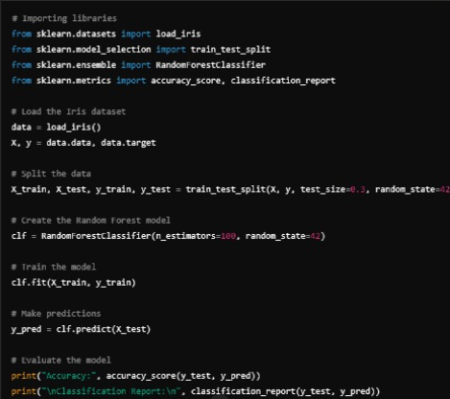
1. Random Forest for Classification

Slide 10
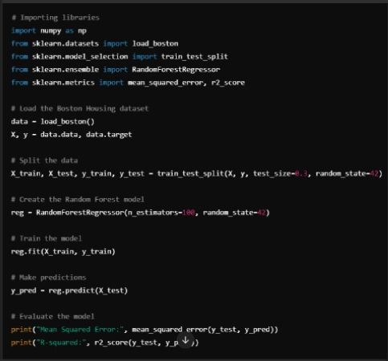
2. Random Forest for Regression

Slide 11
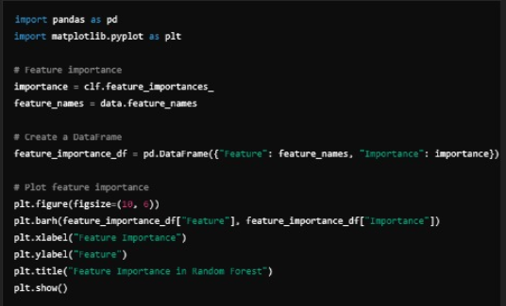
Feature importance in random forest

Slide 12
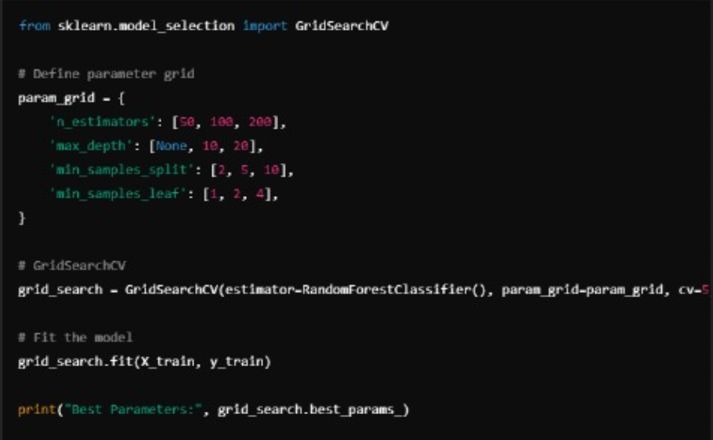
Example of hyperparameter

Slide 13
conclution

Slide 14
-Random Forest is a flexible, easy-to-use algorithm that delivers high performance without extensive hyperparameter tuning.
-It is particularly useful when:
You have noisy data.
Overfitting is a concern.
Feature importance is required.

